Slide 1
Low-rank Matrix Factorization
Feng Shi

Slide 2
Related Papers
On the Wiberg algorithm for matrix factorization in the presence of missing components, 2006, IJCV
Computing smooth time-trajectories for camera and deformable shape in structure from motion with occlusion, 2011, TPAMI

Slide 3
Low-rank Matrix
Motivation: Utilizing the extracted trajectories to denote a video.
Assuming a video have F frames P trajectories:

Slide 4
Why Low-rank?
This is a commonly accepted assumption in computer vision field.
SfM/NRSfM, Motion segmentation…
Low-rank assumption comes from spaio-temporal regularity of motion
A simple sample is translational motion

Slide 5
Why Low-rank?
Rank of S is 4, assume low-rank cannot changed by projection

Slide 6
Why Low-rank?
Complex motion will induce higher rank of W
The rank of W is still assumed to be much smaller than F and P.
This is so called “Low-rank”

Slide 7
Low-rank Matrix Factorization
The acquired matrix W is usually full rank due to inevitable noise in real cases
This fact is not complied with the low-rank assumption
Low-rank matrix factorization can be used to addressed this contradiction

Slide 8
Problem Statement
Compute two matrices to minimize:
When W is complete, one can use the singular value decomposition (SVD).

Slide 9
Missing Data Problem
Compute two matrices to minimize:

Slide 10
Missing Data Problem
Alternation method
Rewritten into a simpler form without M
Repeat
1: compute B to minimize error function
2: compute C to minimize error function
Utill convergence

Slide 11
Alternated Least Squares Algorithm
1:

Slide 12
Alternated Least Squares Algorithm
Linear system of equations: Ax=b

Slide 13
Alternated Least Squares Algorithm
2:

Slide 14
Wiberg Algorithm
1:
2: Using Levenberg–Marquardt algorithm to compute B;

Slide 15
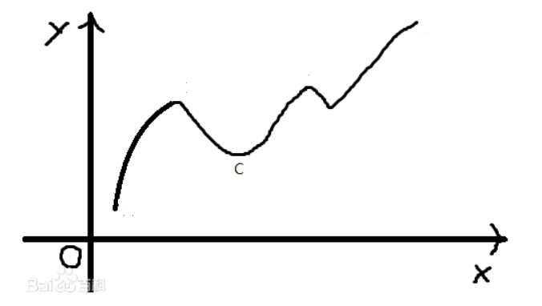
Levenberg–Marquardt Algorithm
Seek such that:

Slide 16
Levenberg–Marquardt Algorithm

Slide 17
Levenberg–Marquardt Algorithm

Slide 18
Levenberg–Marquardt Algorithm

Slide 19
ALS vs Wiberg
ALS algorithm is preferred under mild conditions.
As missing and noise increase, the coveraged time and coveraged rate of Wiberg are much better than those of ALS.
Hybrid method: taking results of ALS as initialization. ALS switches to Wiberg after it iterates 20 times.

Slide 20
Column Space Fitting Algorithm
Motivation: eliminating redundant variables to reduce computational efficiency, memory storage and possibly undesired local optimum

Slide 21
Column Space Fitting Algorithm

Slide 22
Column Space Fitting Algorithm

Slide 23
Column Space Fitting Algorithm

Slide 24
Column Space Fitting Algorithm

Slide 25
Column Space Fitting Algorithm
The second term in is ignored since
So, there is no difference in calculating
since
is approximated

Slide 26
END

